Slide 1

Data Communication CSE 315
Dr. A.K.M. Muzahidul Islam
Professor
Computer Science & Engineering (CSE)
United International University (UIU)
Fall 2018

Slide 2
Resources
Data Communications and Networking. Behrouz A. Forouzan “Chapter 11”

Slide 3
Outline
Byte Stuffing
Bit Stuffing

Slide 4
Data Link Layer
The two main functions of the layer:
Data link control
Deals with the design and procedures for communication between two adjacent nodes: node-to-node communication.
Framing (organize bits that carried out by the PHY Layer)
Flow and Error Control
Software implemented protocols that provide smooth and reliable transmission of frames between nodes
Media access control
Deals with media access control or how to share the link

Slide 5
Framing
Data transmission in the physical layer
Means moving bits in the form of a signal from the source to the destination.
Provides bit synchronization to ensure that the sender and receiver use the same bit durations and timing.
Data transmission in the data link layer
Needs to pack bits into frames, so that each frame is distinguishable from another. Example: Our postal system

Slide 6
Framing separates a message from one source to a destination, or from other messages to other destinations,
By adding a sender address and a destination address.
The destination address: defines where to go;
The sender address: helps the recipient to acknowledge.
In a large frame Flow and Error very inefficient.
Fixed-Size Framing
There is no need for defining the boundaries of the frames.
Example: ATM wide-area network.
Variable-Size Framing
Need a way to define the end of the frame and the beginning of the next.
Example: Local Area Networks (64B ~ 1518B, 4B CRC).
Historically, two approaches were used for this purpose:
a character-oriented approach (Byte Stuffing)
a bit-oriented approach (Bit Stuffing)

Slide 7
Character Stuffing (Byte Stuffing)
Data to be carried are 8-bit characters from a coding system such as ASCII.
The header
Carries the source and destination addresses and other control information
The trailer
Carries error detection or error correction redundant bits
Flag
An 8-bit (1-byte) flag (when Text only, any character other than used in data) is added at the beginning and the end of a frame
To separate one frame from the next i.e. signals the start or end of a frame.

Slide 8
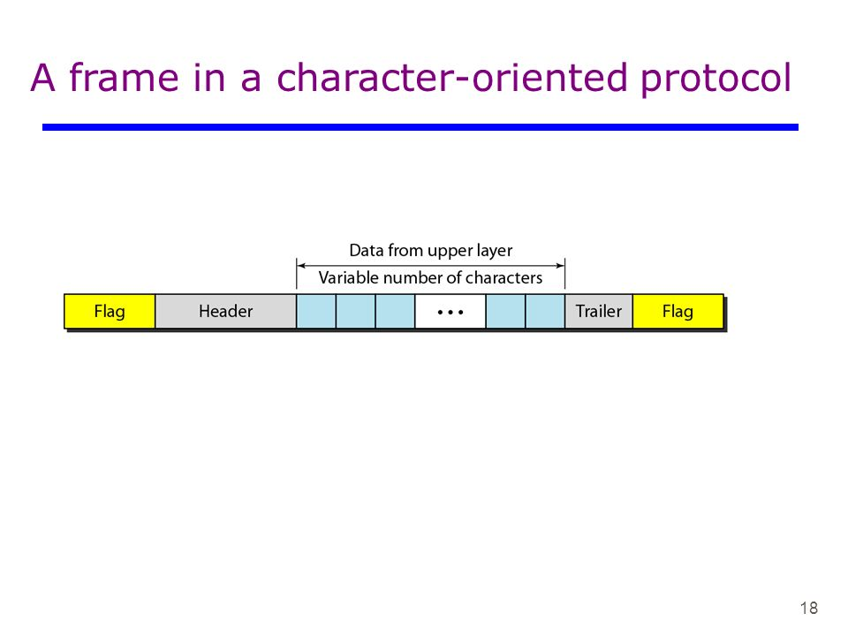

Slide 9
Initially, the flag could be selected to be any character not used for text communication.
Now, we send other types of information
graphs, audio, and video.
Any pattern used for the flag could also be part of the information.
When the receiver encounters this pattern in the middle of the data, thinks it has reached the end of the frame.
To fix this problem
A byte-stuffing strategy was added
A special byte is added to the data section of the frame when there is a character with the same pattern as the flag
Usually call the ESC(escape character), has a predefined bit pattern (27 - decimal).

Slide 10
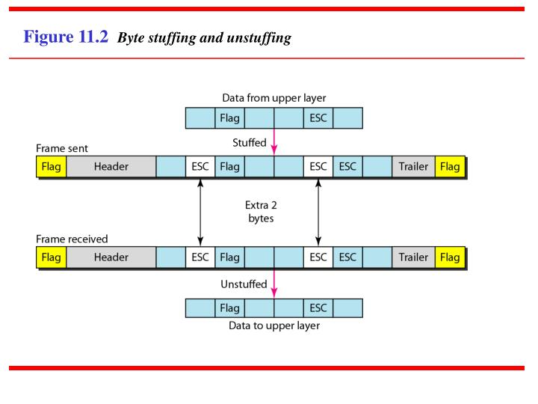

Slide 11
Note:
Byte stuffing is the process of adding one extra byte whenever there is a flag or escape character in the text.

Slide 12
Bit Stuffing
Most protocols use a special 8-bit pattern flag 01111110 as the delimiter to define the beginning and the end of the frame
Stuff 1 single bit (instead of 1 byte) to prevent the pattern from looking like a flag (The strategy is called bit stuffing).
If a 0 and five (05) consecutive 1 (i.e. 011111)bits are encountered, an extra 0 is added, regardless of the value of the next bit.
This extra stuffed bit is eventually removed from the data by the receiver.
This guarantees that the flag field sequence does not inadvertently appear in the frame.

Slide 13
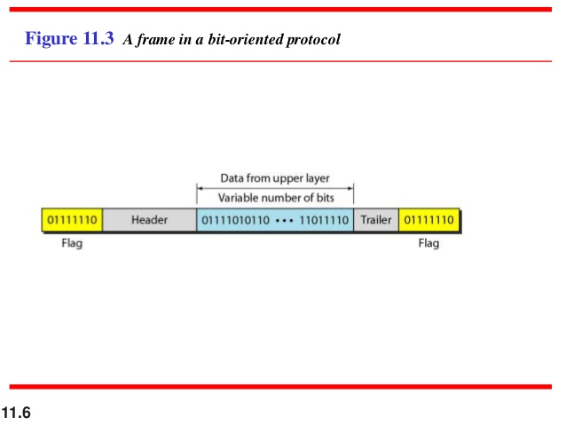

Slide 14
Note:
Bit stuffing is the process of adding one extra 0 whenever there are 5 consecutive 1s (i.e. 111110) in the data so that the receiver does not mistake the data for a flag (01111110).

Slide 15
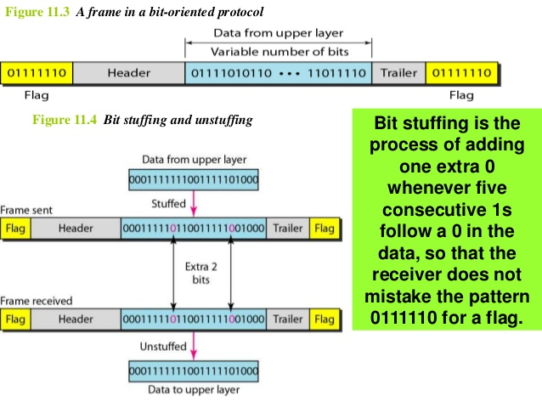

Slide 16


Slide 17
Thank You

